Slide 1
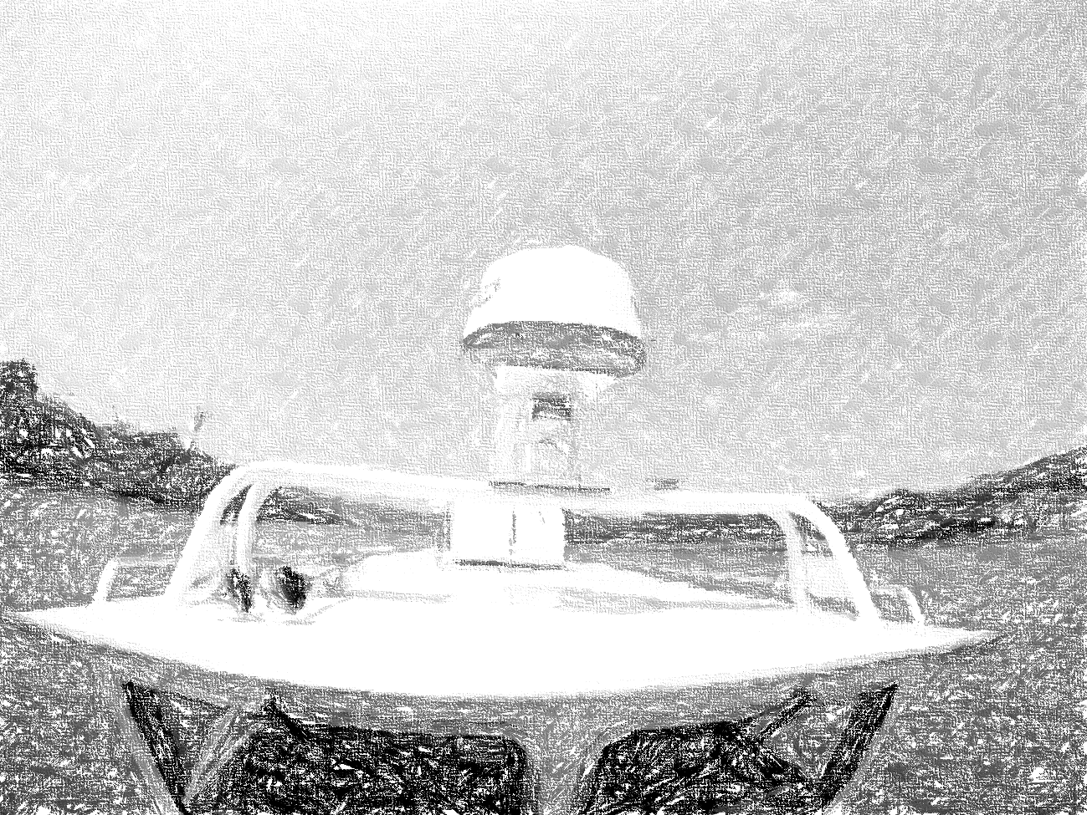


Autonomous Water Taxi
Critical Design Review
By: AutoPirates
Date: 15th December 2015
Project Sponsors:
Team B: Tushar, Shiyu, Bikramjot, Tae-Hyung, William

Slide 2
Content
Project description
Use case/System graphical representation
System-level requirements
Functional architecture
Cyber-physical architecture
Current system status
Project management
Conclusions

Slide 3
Project Description

Slide 4
Project Description
Problem
Pittsburgh lacks a viable river transportation system
Many attractions are located along the river
Currently, only luxury cruise lines available
Solution
AutoPirates is an autonomous water taxi service
A pleasant way to commute to work
More efficient than automobiles in reaching riverfront locations

Slide 5
Use Case

Slide 6

Use Case: System Graphical Representation
James would like to spend a nice day with his family, beginning with some shopping at Walmart, followed by an exciting game at PNC Park, and finally a nice dinner at the Cheesecake Factory in Southside Works.

Slide 7


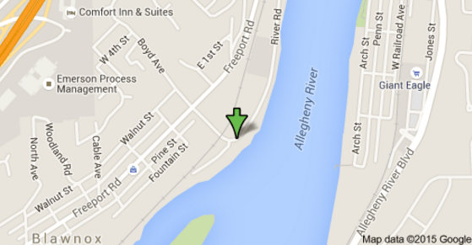
Use Case: System Graphical Representation
Welcome James!
Where you want to go today?
James books the cab from AutoPirates iOS app.
Your Location : Monongahela
Destination : Southside Works
Estimated Fare : $13
Book Now
Powered by AutoPirates

Slide 8
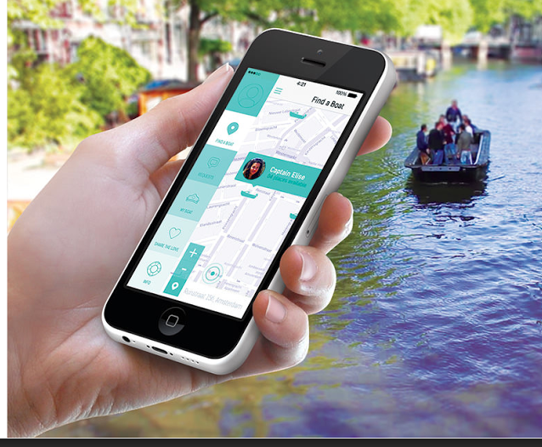
Use Case: System Graphical Representation
Boat arrives to pick James family

Slide 9
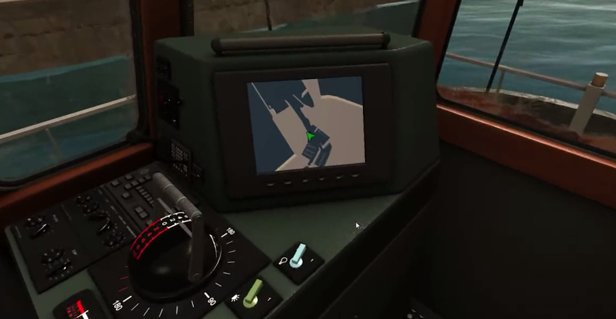
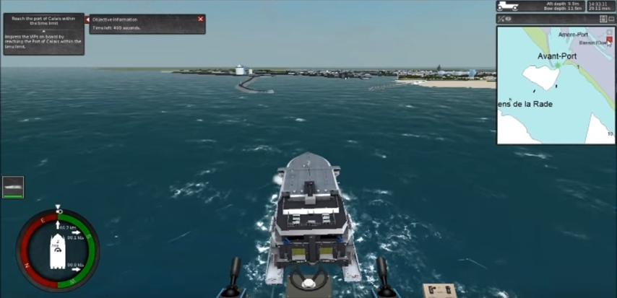
Use Case: System Graphical Representation
James confirms the destination on Operator Control Unit (OCU)
OCU also shows the path to his destination

Slide 10
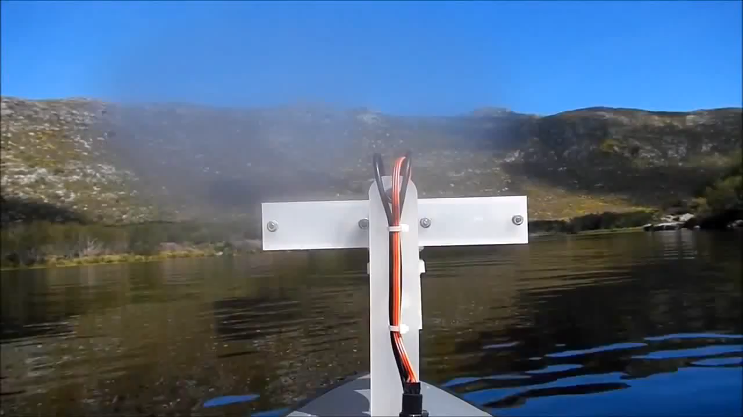
Use Case: System Graphical Representation
Boat avoids obstacles in between the path

Slide 11
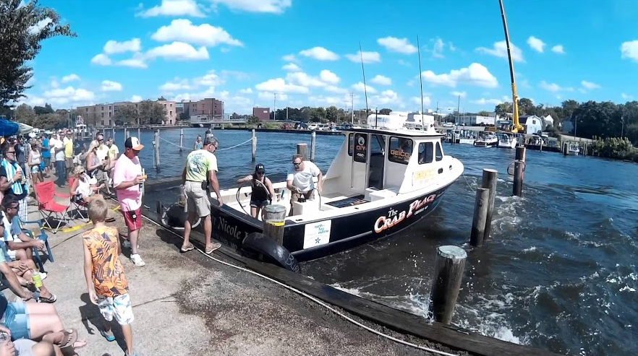
Use Case: System Graphical Representation
The destination arrives

Slide 12
Requirements

Slide 13
System Requirements: Mandatory Functional
The system shall
MF1. Interfacing with low level controller on boat, IMU/GPS and Radar
MF2. Detect static obstacles in the river with minimum size of 2mtx2mtx2mt with more than 85% accuracy.
MF3. Segment shores and bridges
MF4. Autonomously navigate from source to destination at the maximum distance of 2 miles in not more than 15 minutes.
MF5. Avoid detected static obstacles with an accuracy of more than 95%.
MF6. Update the path within 5 sec after detecting new static obstacles.
MF7. Record sensor data up to duration of 15 minutes.
MF8. Replay saved sensor data.
MF9. Have a 2D simulator to test path planning algorithm.
MF.10 Generate Occupancy grid map of environment

Slide 14
System Requirements
Desirable functional requirements
The system shall -
DF1. Track dynamic obstacles with minimum size of 1m x 1m x 1m.
DF2. Update the path within 2sec after detecting new dynamic obstacles.
Mandatory non-functional requirements
The system shall -
MNF1. Be tested in 25-30 field trials.
MNF2. Arrive within a radius of 15 meters of the desired destination.
MNF3. Be demonstrated in a video.
MNF4. Sail at a velocity not more than 15 mph.
Desirable non-functional requirements
The system shall -
DNF1. Obey the “rules of the road”.
DNF2. Estimate the shape of the static obstacles in the river with a minimum of 50% overlap.

Slide 15
Architectures

Slide 16
Functional Architecture: Defining functions of the project
Log Data
No
*Not in planned scope
Destination reached?
Get current location and localize
Plan route from current location to destination
Send commands to controller
Autonomously sail to destination
IMU/GPS
Yes
User Input
Get destination
Destination
Detect Dynamic Obstacles*
Estimate path of obstacle*
Planning
Acquire data from Sensors
Filter data
OCU
Radar
Detect Static Obstacles
Perception
Log Data
Log Playback

Slide 17
Functional Architecture: Functioning with logged data and simulator
No
Destination reached?
Get current location and localize
Plan route from current location to destination
Autonomously sail to destination in simulator
Logged IMU/GPS
Yes
Input (Config params)
Get destination
Destination
Planning
Acquire data
Filter data
Detect Static Obstacles
User Input
Logged Radar Data
Perception
Log Playback

Slide 18
Cyberphysical Architecture
Da
Data Acquisition System
Da
Da
Software System (Laptop)
OCU (Laptop)
Radar (Simrad 4G FMCW)
Raw Radar Data
Perception Algorithm
Destination Input from User on GUI
Da
Da
Low Level Controller
(ARM based proprietary FPGA board of NREC)
Single Board Computer
(SBC running Linux and connected to LAN (Based on ROS))
Obstacles Data
IMU/GPS (Novotel Span)
GPS/IMU Input and Output
Publish IMU/GPS data as ROS TOPIC
LAN
Path Planning Algorithm
Display Map and current Location
Control Throttle and steering
Send Commands to control boat
Send GPS waypoints to control boat (ROS Topic)
LAN
Same or different Laptop or Tablet as in software system
Development using ROS in C++
Engine and Steering Controller (Inbuilt)
Da
Engine and steering controller
Engine (Twin 150 HP Engine) and Steering
SeaHawk OS 2700S

Slide 19
Current Status

Slide 20
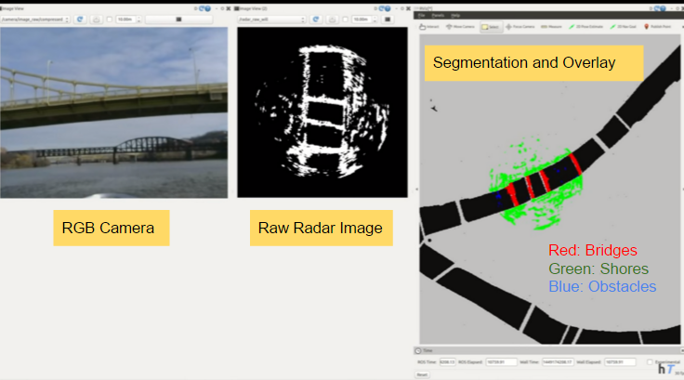
Current Status: Perception

Slide 21
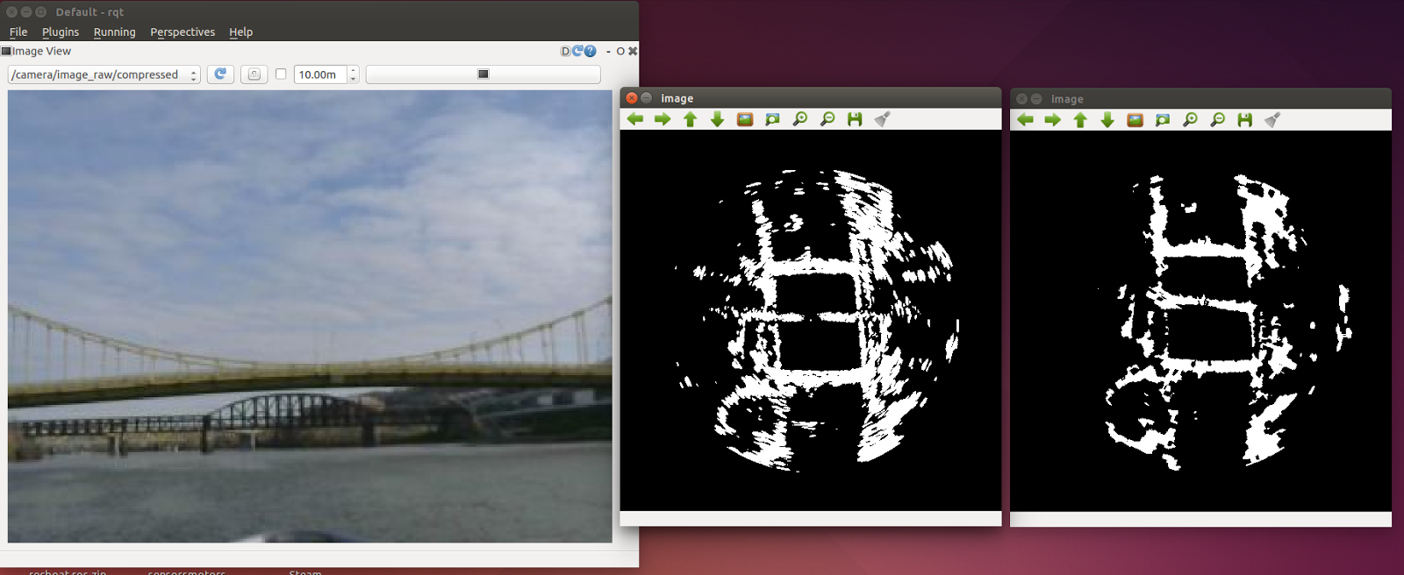
Current Status: Perception | Filter
Binomial Probabilistic Filter
Binomial Probabilistic Filter
Before Filtering
After Filtering

Slide 22
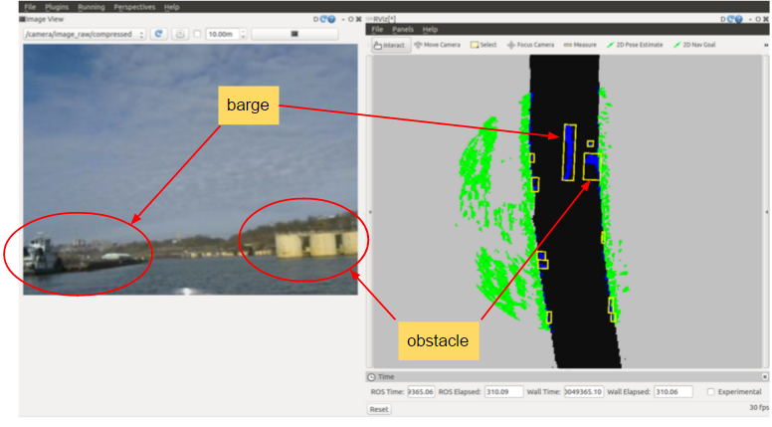
Current Status: Perception | Detection

Slide 23
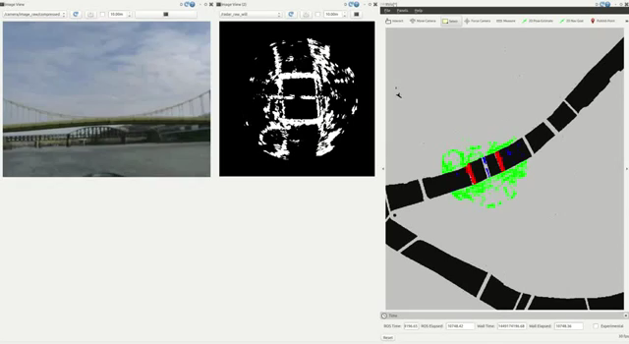
Current Status: Perception | Video

Slide 24

Current Status: Path Planning | Occupancy Grid Map
Vanilla Occupancy Grid Map

Slide 25

Current Status: Path Planning | Occupancy Grid Map
Obstacles added to Occupancy Grid Map

Slide 26

Current Status: Path Planning | Occupancy Grid Map
Added Cost to locations near obstacles and shores

Slide 27
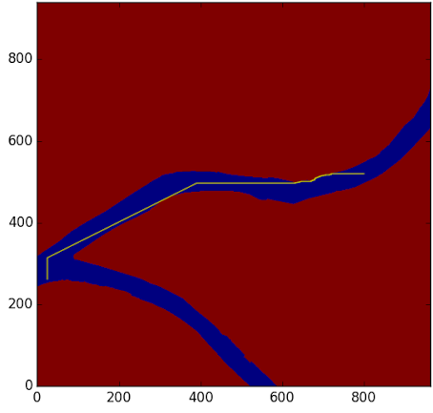
Current Status: Path Planning | Search Algorithms
Path planning using ARA* algorithm

Slide 28
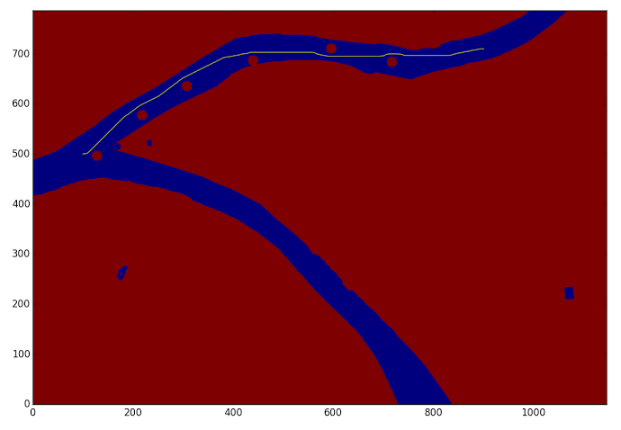
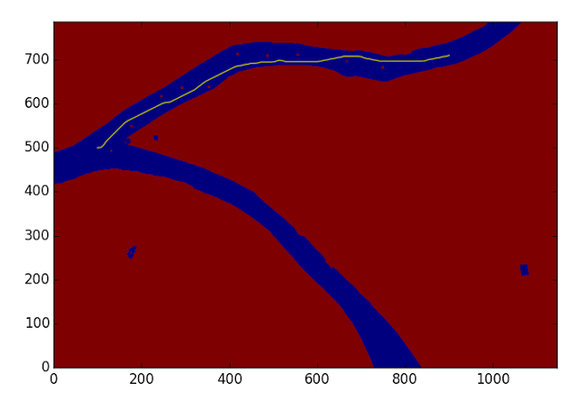
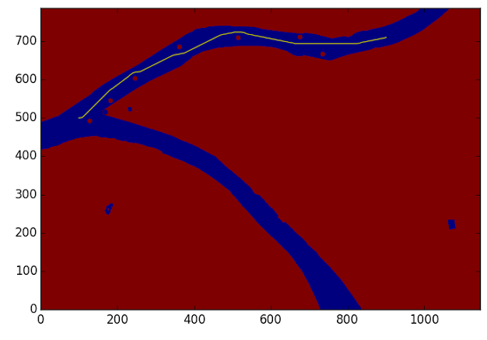
Current Status: Path Planning | Search Algorithms
After tuning motion primitives

Slide 29
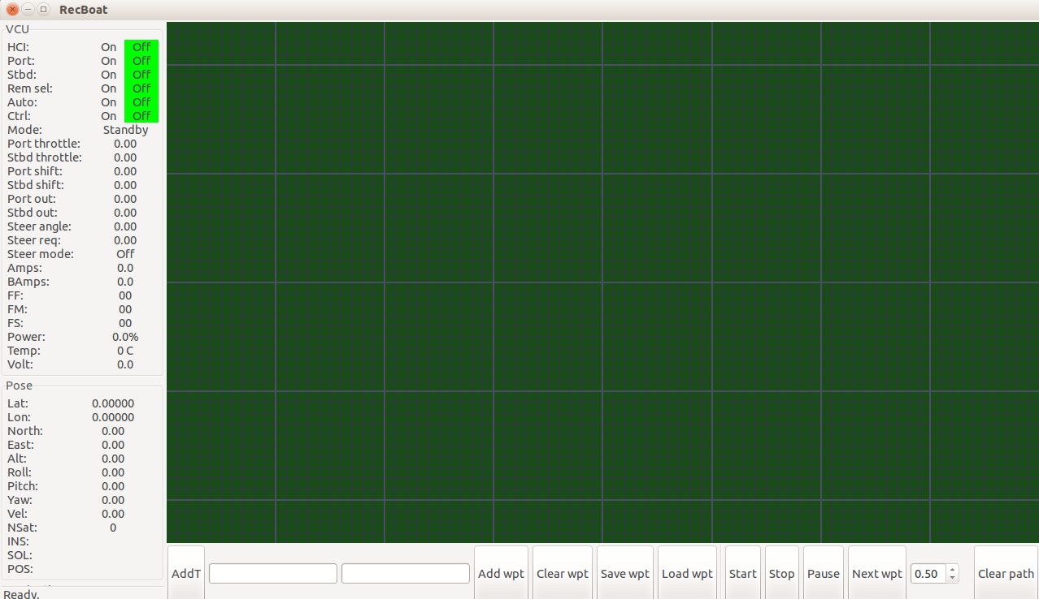
Current Status: Path Planning | Added New Feature to GUI
Added text boxes to input waypoints in GUI

Slide 30
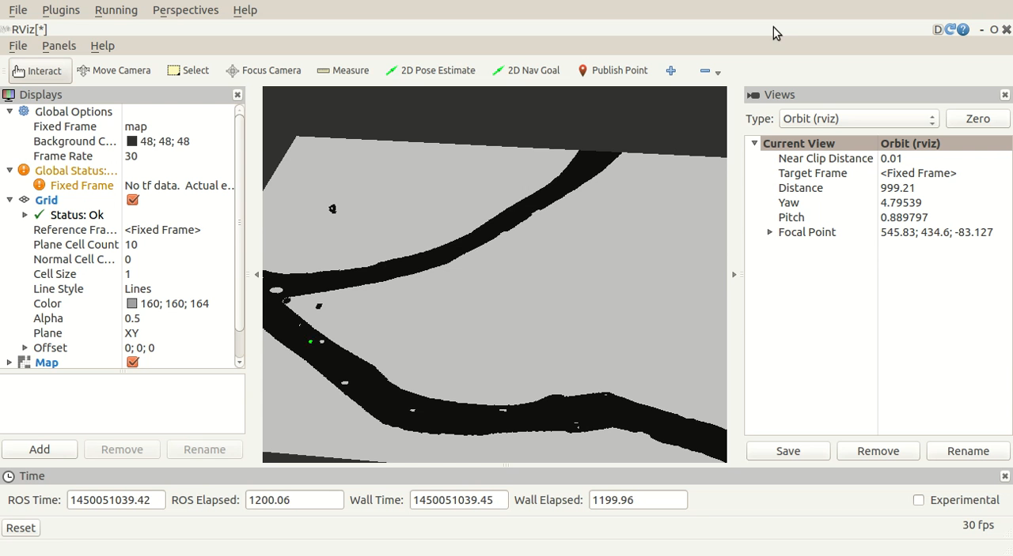
Current Status: Path Planning | Simulator

Slide 31
Fall Validation Experiments: Perception
Step ID | Req. | Step Description | Success Criteria | FVE | FVE Encore | Conditions
PE.1 | MF7, MF8 | Start RGB video of field test | This is our ground truth | Successful | Successful | Location: NSH Demonstration on laptop (Simulation), Projector required
PE.2 | MF7, MF8 | Simultaneously replay and visualize saved raw radar data in ROS | We can see plots of the radar image | Successful | Successful
PE.3 | MF3 | Show filtered data | The filtered image has less noise than the raw image | Few false positives detected | Improved but requires more testing
PE.4 | MF2 | Demonstrate obstacle detection | Draw bounding box around the obstacles. | Successful | Successful
PE.5 | MF2 | Show detected objects from radar image while showing recorded video | The radar should detect obstacles that are in the video, at least the boats (75% success) | Few false positives detected | Need to categorize performance for quantitatively

Slide 32
Fall Validation Experiments: Path Planning and Simulator
Step ID | Req. | Step Description | Success Criteria | FVE | FVE Encore | Conditions
PL.1 | MF1 | Interfacing with IMU/GPS | Display logged data from IMU/GPS which we would be collecting during a field test | Successful | Successful | Location: NSH Demonstration on laptop (Simulation), Projector required
PL.2 | MF10 | Generate Environment Map | Display occupancy grid map for 2 miles with filled blocks depicting obstacles (For one of the rivers of Pittsburgh) | Successful | Successful
PL.3 | MF4 | Demonstrate Path Planning | Boat successfully navigates from Point A to Point B in simulator which are 1 mile apart | Successful | Successful
PL.4 | MF5,MF9 | Show obstacle avoidance | Boat successfully avoids obstacles in simulator in the above task. Obstacles are static and are simulated through occupancy grip map | Required to demonstrate with different size and number of obstacles | Successful

Slide 33
Project Management

Slide 34
Work Breakdown Structure
Autonomous Water Taxi
Perception
Path planning
Mapping & Localization
Simulator
Integration
Testing
Project Management
Get raw data from Radar
Interface IMU/GPS
Import external navigation map
Generate a world model
Integrate OpenCPN with ROS
Sensor test
Task scheduling
Position and pose estimation
Algorithms test
Field management
Filter data
Generate occupancy grid map
Apply path planning algorithm to the boat model
Integrate SBPL library with external map
Morphological operation
Interface SBPL library
Field test
Budget management
Localize boat on the map
Integrate perception with path planning
Performance evaluation
Risk management
Contour extraction
Algorithm evaluation
Overlay radar image on the map
Evaluate performance for obstacles avoidance
Obstacle detection
Send command to low-level controller
Optimize radar filters
Dynamically run planner
Subsystem
Finished
In progress
Not started

Slide 35
Project Status: WBS Milestones for FVE
Perception
Path Planning
Acquire data using OpenCPN
10/12
Tests and Demo’s
Interface with IMU
10/12
Interface Radar with ROS
10/29
PR1
10/15
Build and explore SBPL
10/26
Legend
Basic Data Filtering
11/07
PR2
10/12
Generate Occupancy Grid Map
11/10
Finished
Morphological operation
11/14
PR3
10/12
Test Occupancy Grid Map on STAGE Simulator
11/13
In progress
Contour Extraction
11/18
PR4
10/12
Run planner on OGM to plan the path
11/24
Not started
Object Detection (Boundary box)
11/24
Field Test1
11/17
Create waypoint following interface
11/28
Start with overlaying radar data on maps
12/01
FVE
12/03
Tune motion primitives and OGM
12/02

Slide 36
Spring Validation Experiments: Script for final demo
PR No. | Time | Milestones
PR.7 | Late January | Improve costmap functionality and path planning simulation
PR.8 | Mid-February | Integrate radar obstacles with path planner
PR.9 | Late February | Integrate with boat
PR.10 | Mid-March | Improve path planning efficiency
PR.11 | Early April | Improve radar filtering and efficiency
PR.12 | Mid-April | Identify and practice exact scenario for SVE

Slide 37
Spring Validation Experiments: Script for final demo
Step ID | Step Description | Success Criteria | Conditions
SV.1 | Get the boat on the river | Location: center of width | Location: Allegheny River (Exact location is yet to be provided by the sponsor) Equipment /Arrangements: Boat, Radar, IMU/GPS, Fuel, Laptop in boat, Camera to record video, safety driver
SV.2 | Keep 5 static obstacles in the path | Size more than 2mx2mx2m
SV.3 | Switch on the engines and start AutoPirates autonomous system | The system starts successfully
SV.4 | Enter the destination through OCU | OCU takes the location correctly
SV.5 | The boat navigates autonomously and avoids obstacles | Boat avoids at least 4 obstacles
SV.6 | The boat arrives the destination | Boat arrives to destination (15 mts radius)
SV.7 | Show logged file | Play back logged data
SV.8 | Turn off the autonomous system and engine | System switches off without any error

Slide 38
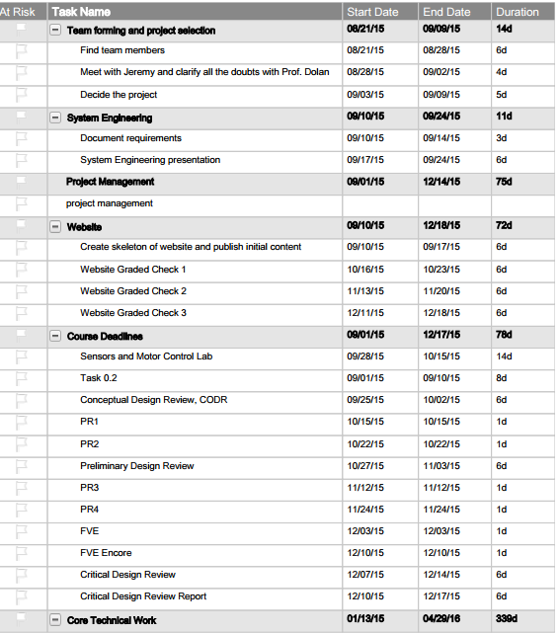
Schedule: 1

Slide 39
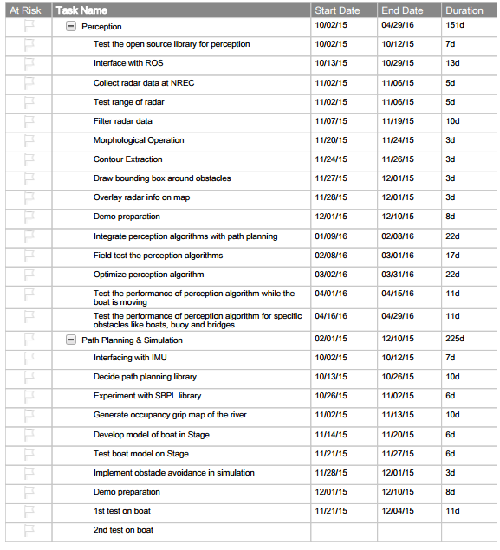
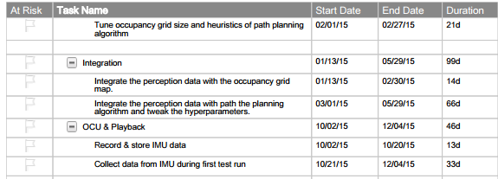
Schedule: 2

Slide 40
Budget Allocation
Hardware/Equipment/Budget provided by the sponsor (NREC)
S.No | Part | Part Name | Quantity
1 | Boat | 2015 SeaHawk OS 2700S | 1
2 | Radar | SimRad 4G FMCW Radar | 1
3 | Lidar | Velodyne VLP-16 | 1
4 | IMU/GPS | Novatel SPAN with IMU positioning | 1
5 | Laptop | Dell i7 | 5
6 | Proprietary Boards | SBC and Microcontroller boards | 2
7 | Trails for testing | $800 per trial | 25 (trails)
From RI Budget $4000
S.No | Name | Description | Quantity | Cost | Total | Spent | Left
1 | Transportation | Travel to NREC (5 people) | 64 | 25 | 1600 | 50 | 1550
2 | Videography | Professional video for NREC | 1 | 500 | 500 | 0 | 500
3 | Backup for Trails | Incase we run out of allotted 25 trails | 2 | 800 | 1600 | 0 | 1600
4 | Miscellaneous | To buy camera, contraption, books, etc | 1 | 300 | 300 | 54 | 246
Available
3896

Slide 41
Risk Assessment
Risk ID | Risk Title | Req | Type | Description | Impact Statement | Likeli- hood (1-5) | Conse- quences(1-5) | Mitigating Actions
1 | Test environment availability | All | Testing | Won’t be able to do field testing because of weather conditions | Delay in the progress and insufficient data collect for algorithms | 4 | 3 | Test radar perception on shore for static obstacles. Use a simulator for path planning
2 | Limited testing trials | MNFR2 | Project management | Only 25-30 field tests | Unable to do system integration before demonstration | 5 | 3 | Appoint a field manager to plan logistics of each test.
3 | Radar Performance | MF2, MF3, DF1, DF2 | Technical | Radar signal is too noisy | Inadequate object detection with only radar | 3 | 4 | Incorporate additional sensors like Lidar and camera

Slide 42
Risk Assessment
Risk ID | Risk Title | Req | Type | Description | Impact Statement | Likeli- Hood (1-5) | Conse- Quences (1-5) | Mitigating Actions
4 | Radar cannot detect bridge supports | All | Technical | The Radar only has 2D information | We can’t plan path without knowing the location of the bridge supports | 5 | 5 | Research nautical maps that has information for the bridge supports
5 | Code Efficiency | All | Technical | Code may run too slow after integration | Poor system performance | 5 | 4 | Integration early and often to identify bottlenecks
6 | Team Communication | All | Project management | Language barrier in the team | It may be difficult to express ideas. | 4 | 2 | Do more preparations before the meetings

Slide 43
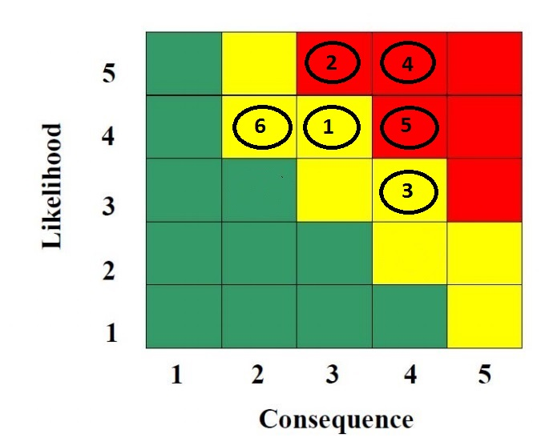
Risk Assessment

Slide 44
Conclusion

Slide 45
Conclusion
Strengths
Technical Support from NREC
The radar and IMU have high accuracy
The boat hardware is well-built
The radar noise on river is much decreased than on shore
Rosbag
Jugaad
Weaknessess
Limited experience in radar, path planning and field test
ROS doesn’t have good support for radar
The bridge columns is hard to detect
The SBPL global planner takes long time to run
Matching the scale of radar to the map

Slide 46
Questions

Slide 47
Subsystems

Slide 48
Subsystem: Perception
Log Data
Interface with ROS
Ego motion compensation
Data Filtering
Morphological operation (open/close)
Acquire data using OpenCPN
Obstacle Data Object
Object Detection (Boundary box)
Contour Extraction
Radar Data
Path Planning Algorithm

Slide 49
Subsystem: Path Planning
Obstacles data from perception algorithms
Log Data
IMU/GPS
Data from ROS Topic (SBC)
Get current location
Filter and localize
Add obstacles to Occupancy Grid Map
Path Planner
Operator Control Interface (OCU)
Create Occupancy Grid Map and motion primitives
Send GPS waypoints to SBC
Get GPS waypoints of next grid location
Single Board Computer (SBC)

Slide 50
Subsystem: Simulator
Sample obstacle data for testing
Recorded data (ROS Topic)
Get current location
Localize
Add obstacles to Occupancy Grid Map
Path Planner
Visualization of path
Create Occupancy Grid Map of environment

